Slide 1
Graph Traversals: DFS BFS Performance Analysis

Slide 2
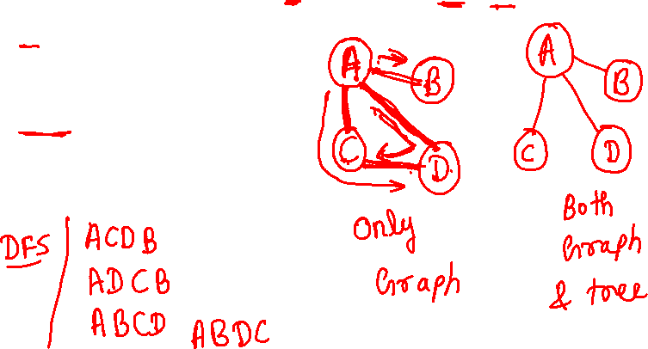
Some Graph Operations
Traversal Given G=(V,E) and vertex v, find all w∈V, such that w connects v.
Depth First Search (DFS) preorder tree traversal
Breadth First Search (BFS) level order tree traversal

Slide 3
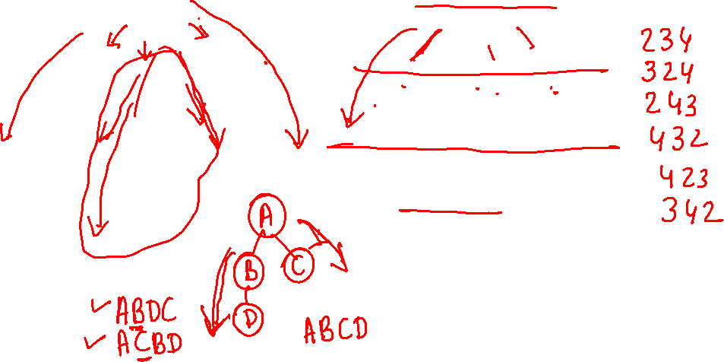


Slide 4
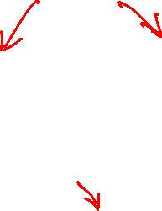
Depth-first search
A depth-first search (DFS) explores a path all the way to a leaf before backtracking and exploring another path
For example, after searching A, then B, then D, the search backtracks and tries another path from B
Node are explored in the order A B D E H L M N I O P C F G J K Q
A
B
C
D
E
F
G
H
I
J
K
L
M
N
O
P
Q

Slide 5
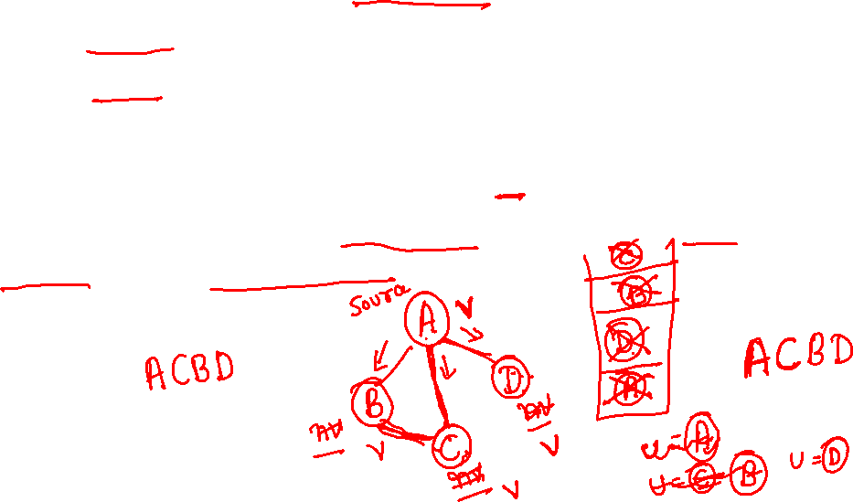
DFS Algorithm
Mark all the n vertices as not visited.
insert source into stack and mark it visited
while(Stack is not empty)
{
delete Stack element into variable u
place all the adjacent (not visited) vertices of u into Stack and also mark them visited
print u
}

Slide 6
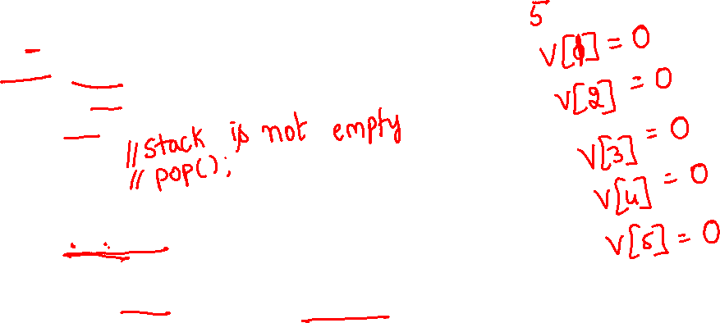
void dfs(int a[20][20],int n,int source)
{ int visited[10],u,v,i;
for(i=1;i<=n;i++) visited[i]=0;
int S[20],top=-1;
S[++top]=source;
visited[source]=1;
while(top>=0)
{ u=S[top--];
for(v=1;v<=n;v++)
{ if(a[u][v]==1 && visited[v]==0)
{
visited[v]=1; S[++top]=v;
}
}
cout<<u<<" ";
}
}

Slide 7
Breadth first search
It is so named because
It discovers all vertices at distance k from s before discovering vertices at distance k+1.

Slide 8
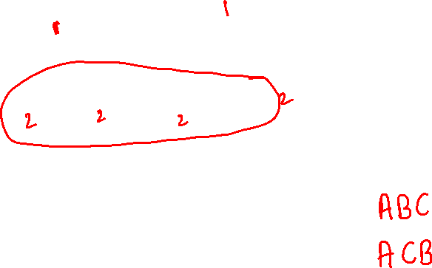
Breadth-first search
A breadth-first search (BFS) explores nodes nearest the root before exploring nodes further away
For example, after searching A, then B, then C, the search proceeds with D, E, F, G
Node are explored in the order A B C D E F G H I J K L M N O P Q
A
B
C
D
E
F
G
H
I
J
K
L
M
N
O
P
Q

Slide 9

Algorithm BFS
Mark all the n vertices as not visited.
insert source into Q and mark it visited
while(Q is not empty)
{
delete Q element into variable u
place all the adjacent (not visited) vertices of u into Q and also mark them visited
print u
}

Slide 10
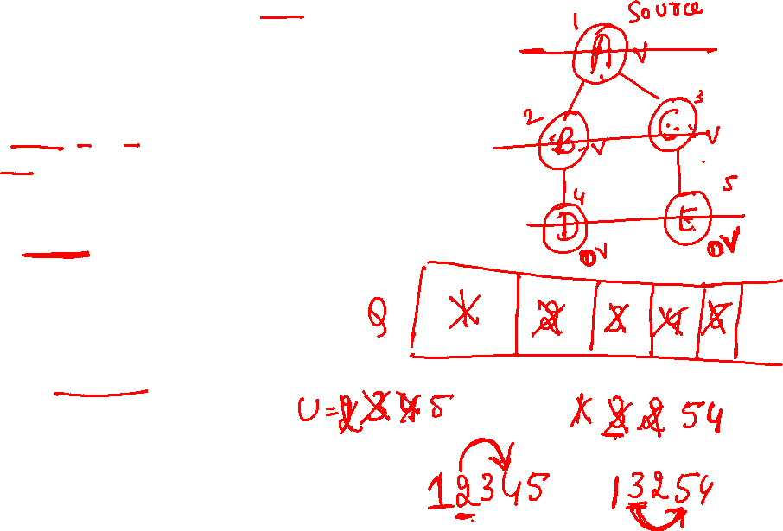
void bfs(int a[20][20],int n,int source)
{
int visited[10],u,v,i;
for(i=1;i<=n;i++) visited[i]=0;
int Q[20],f=-1,r=-1;
Q[++r]=source; visited[source]=1;
while(f<r)
{
u=Q[++f];
for(v=1;v<=n;v++)
{ if(a[u][v]==1 && visited[v]==0)
{
visited[v]=1;
Q[++r]=v;
}
}
cout<<u<<" ";
}
}

Slide 11
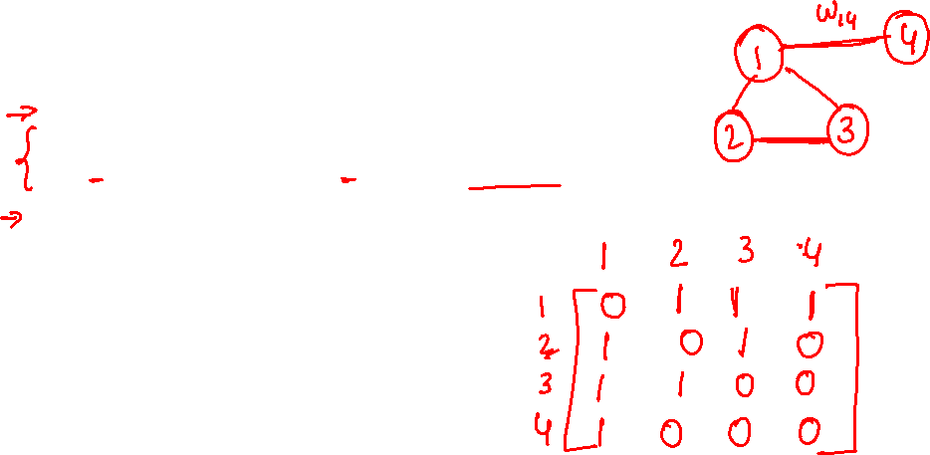
#include<iostream.h>
void bfs(int a[20][20],int n,int source);
void dfs(int a[20][20],int n,int source);
int main()
{
int a[20][20],source, n,i,j;
cout<<"Enter the no of vertices: "; cin>>n;
cout<<"Enter the adjacency matrix: ";
for(i=1;i<=n;i++) for(j=1;j<=n;j++) cin>>a[i][j];
cout<<"Enter the source: ";
cin>>source;
cout<<"\n BFS: "; bfs(a,n,source);
cout<<"\n DFS: "; dfs(a,n,source);
return 1;
}

Slide 12
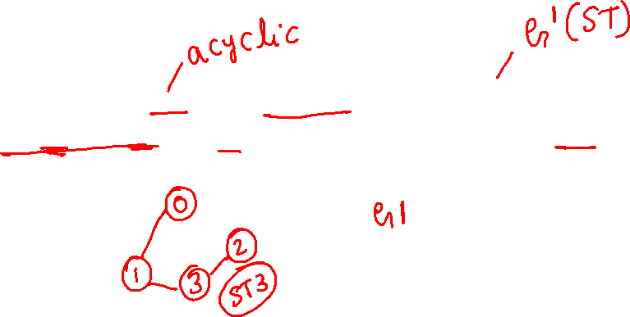
Spanning Tree (ST)
A spanning tree is a minimal subgraph G’, such that V(G’)=V(G) and G’ is connected. Spanning Tree is always acyclic.
3
1
2
0
2
3
0
1
2
1
3
0
0
0
3
0
1
2
1
2
1
2
G1
3
3
ST1(G)
ST2(G)

Slide 15
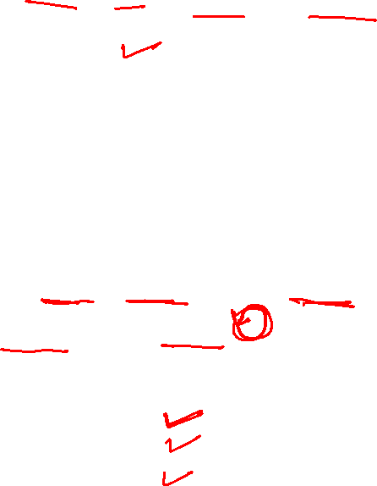
How to create programs
Requirements
Analysis: bottom-up vs. top-down
top-down: Breaks the massive problem into smaller subproblems. (Structured programming Eg: C)
bottom-up: Solves the fundamental low-level problem and integrates them into a larger one. (OOP)
Design: data, objects and operations
Refinement and Coding
Verification
Program Proving
Testing
Debugging

Slide 16
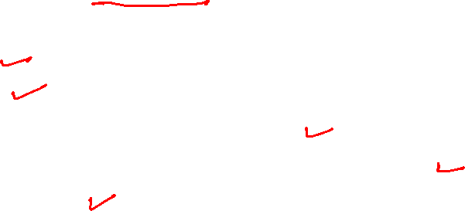
Algorithm
Definition An algorithm is a finite set of instructions that accomplishes a particular task.
Criteria
input
output
definiteness: clear and unambiguous
finiteness: terminate after a finite number of steps
effectiveness:

Slide 17

Properties of an Algorithm:
An algorithm must satisfy the following properties:
Input: The algorithm must have input values from a specified set.
Output: The algorithm must produce the output values from a specified set of input values. The output values are the solution to a problem.
Finiteness: For any input, the algorithm must terminate after a finite number of steps.
Definiteness: All steps of the algorithm must be precisely defined.
Effectiveness: It must be possible to perform each step of the algorithm correctly and in a finite amount of time.

Slide 18
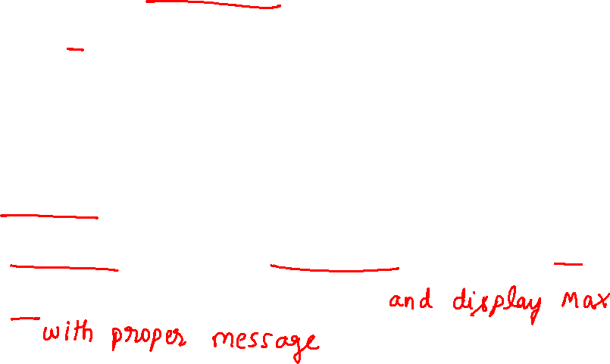
A sample Algorithm
Problem: Given a list of positive numbers, return the largest number on the list.
Inputs: A list L of positive numbers. This list must contain at least one number. (Asking for the largest number in a list of no numbers is not a meaningful question.)
Outputs: A number n, which will be the largest number of the list.
Algorithm:
Step1: Set max to 0.
Step 2: For each number x in the list L, compare it to max. If x is larger, set max to x.
Step 3: max is now set to the largest number in the list.

Slide 19
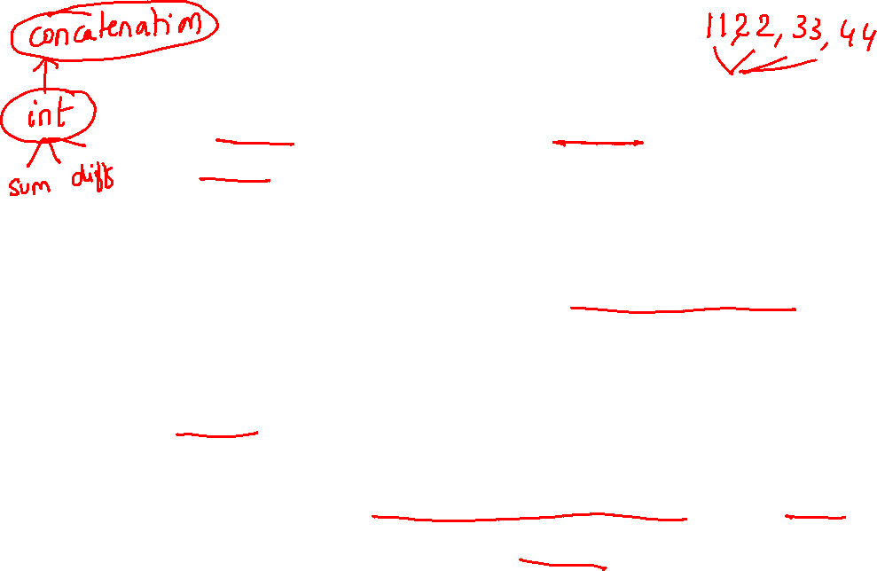
Data Type
Data Type A data type is a collection of objects and a set of operations that act on those objects.
Abstract Data Type An abstract data type(ADT) is a data type that is organized in such a way that the specification of the objects and the operations on the objects is separated.
Abstract data type are like user defined data type on which we can perform functions without knowing what is there inside the datatype and how the operations are performed on them.

Slide 20

An abstract data type (ADT) is basically a logical description or a specification of components of the data and the operations that are allowed, that is independent of the implementation.
ADTs are a theoretical concept in computer science, used in the design and analysis of algorithms, data structures, and software systems, and do not correspond to specific features of computer languages.
There may be thousands of ways in which a given ADT can be implemented, even when the coding language remains constant. Any such implementation must comply with the content-wise and behavioral description of the ADT.

Slide 21
Specification vs. Implementation
Operation specification
function name
the types of arguments
the type of the results
Implementation independent

Slide 22
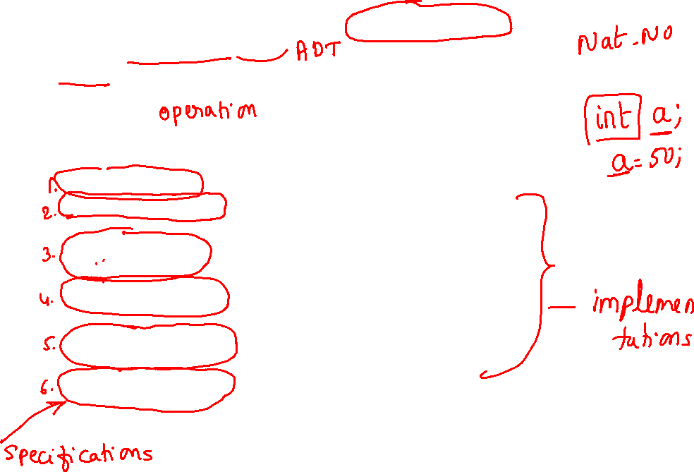
*Structure 1.1:Abstract data type Natural_Number (p.17) structure Natural_Number is objects: an ordered subrange of the integers starting at zero and ending at the maximum integer (INT_MAX) on the computer functions: for all x, y ∈ Nat_Number; TRUE, FALSE ∈ Boolean and where +, -, <, and == are the usual integer operations. Nat_No Zero ( ) ::= 0 Boolean Is_Zero(x) ::= if (x) return FALSE else return TRUE Nat_No Add(x, y) ::= if ((x+y) <= INT_MAX) return x+y else return INT_MAX Boolean Equal(x,y) ::= if (x== y) return TRUE else return FALSE Nat_No Successor(x) ::= if (x == INT_MAX) return x else return x+1 Nat_No Subtract(x,y) ::= if (x<y) return 0 else return x-y end Natural_Number
::= is defined as

Slide 23
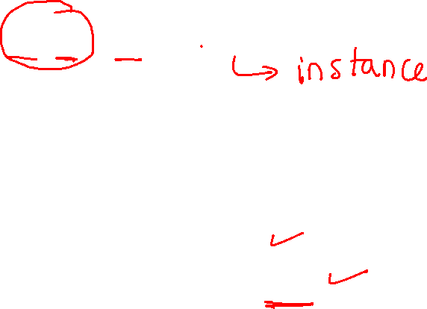
Space Complexity S(P)=C+S_{P}(I)
The space needed by a program is the sum of the following components:
Fixed Space Requirements (C)
Variable Space Requirements (S_{P}(I))

Slide 24
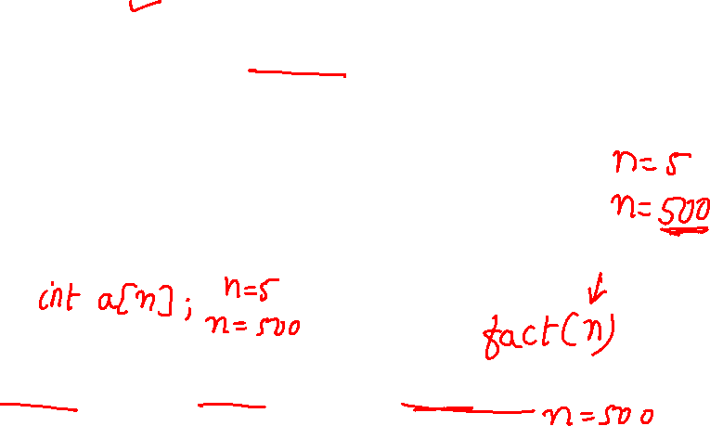
Fixed Space Requirements (C) Independent of the characteristics of the inputs and outputs
instruction space
space for simple variables, fixed-size structured variable, constants
Variable Space Requirements (S_{P}(I)) depend on the instance characteristic I
number, size, values of inputs and outputs associated with I
recursive stack space
local variable, formal parameter, depth of recursion

Slide 25
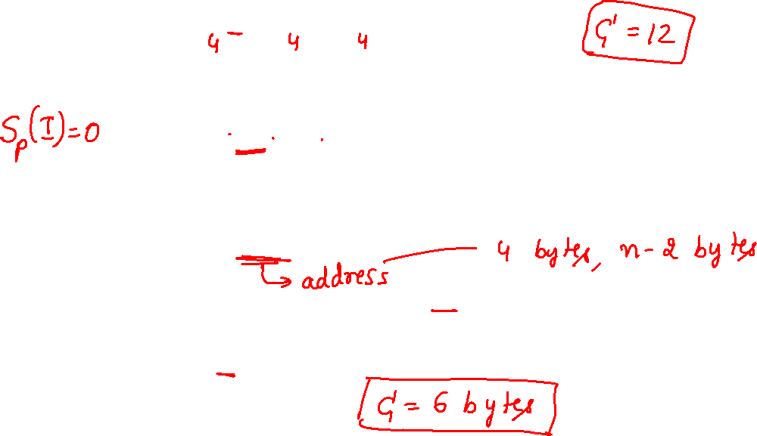
*Program 1.9: Simple arithmetic function (p.19) float abc(float a, float b, float c) { return a + b + b * c + (a + b - c) / (a + b) + 4.00; } *Program 1.10: Iterative function for summing a list of numbers (p.20) float sum(float list[ ], int n) { float tempsum = 0; int i; for (i = 0; i<n; i++) tempsum += list [i]; return tempsum; }
S_{abc}(I) = 0
S_{sum}(I) = 0
Recall: pass the address of the
first element of the array &

Slide 26
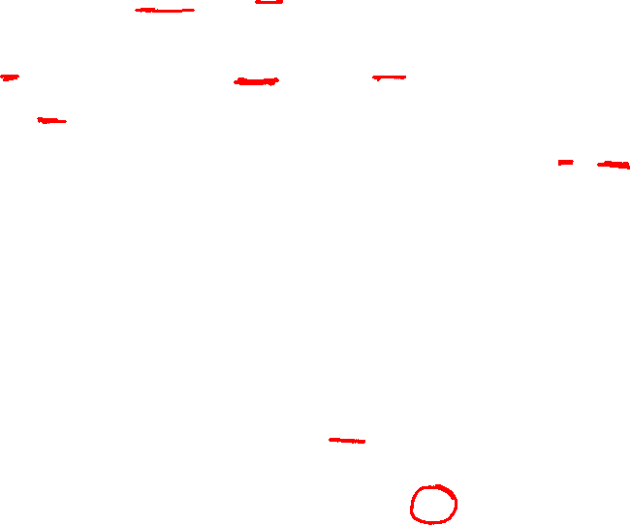

*Program 1.11: Recursive function for summing a list of numbers (p.20) float rsum(float list[ ], int n) { if (n) return rsum(list, n-1) + list[n-1]; return 0; } *Figure 1.1: Space needed for one recursive call of Program 1.11 (p.21)
S_{sum}(I)=S_{sum}(n)=6n
Assumptions:

Slide 27
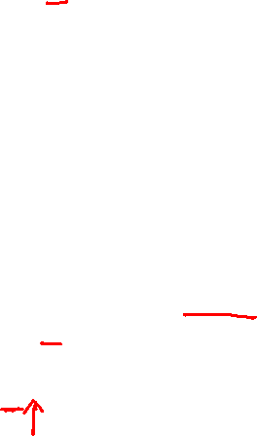
Examples on Space Complexity
int Fact ( int n)
{
if ( n <= 1) return 1;
else return n * Fact ( n – 1);
}
What is the space complexity S(P) for a given code?
Depth of the recursion = n or max{n,1}
For each recursion space requirements are
return address: 2 bytes
n : 2 bytes
SFact(n) = 4n or 4 *max {n,1}

Slide 28

Time Complexity
T(P)=C+T_{P}(I)
Compile time (C) independent of instance characteristics
run (execution) time T_{P}

Slide 29

Time Complexity
A program step is a syntactically or semantically meaningful program segment whose execution time is independent of the instance characteristics.
Example
abc = a + b + b * c + (a + b - c) / (a + b) + 4.0
abc = a + b + c
Regard as the same unit
machine independent

Slide 30
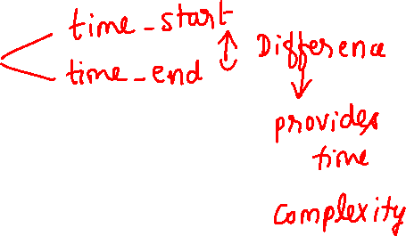
Methods to compute the step count
Introduce variable count into programs
Tabular method
Determine the total number of steps contributed by each statement step per execution × frequency
add up the contribution of all statements

Slide 31
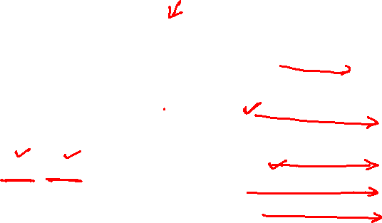
*Figure 1.2: Step count table for Program 1.10 (p.26)
Tabular Method
Iterative function to sum a list of numbers
steps/execution

Slide 32
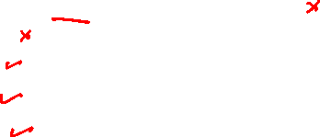
*Figure 1.3: Step count table for recursive summing function (p.27)
Recursive Function to sum of a list of numbers

Slide 33
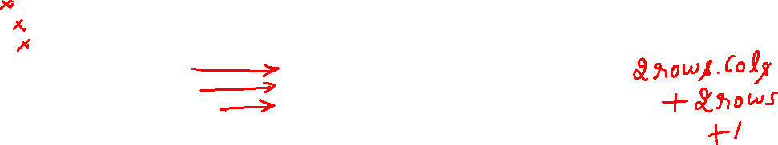
*Figure 1.4: Step count table for matrix addition (p.27)
Matrix Addition

